Slide 1
start 1 July
clock in view – time right
ending alarm set: 18 mins
pointer option: visible, green
count-up timer in hand
Notes:
Tablet on stop watch > easy to reset; has no noise; I’m free to adjust the stop
Word doc for mind exercise
Book 1 p 274 visualisation text
Movement text
dictation– Soldier Hans Anderson
When running a Power point show, the b-key toggles the screen blank, with light off.
Mouse click to move slide or not > transitions tab | check box under Advance slide

Slide 2
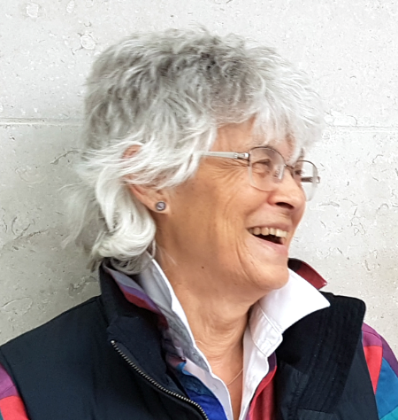
Supporting Generic Processing Skills 1 July 2025
Ginny Stacey
timer started
Notes:
Alarm set on tablet
Tablet on stop watch > easy to reset; has no noise; I’m free to adjust the stop
When running a Power point show, the b-key toggles the screen blank, with light off.
Mouse click to move slide or not > transitions tab | check box under Advance slide

Slide 3
Underlying focus
vital for dyslexic/ SpLD students
good practice for all
a whole school approach that
caters for dyslexic/ SpLD students
minimal extra for teachers
good for resources

Slide 4
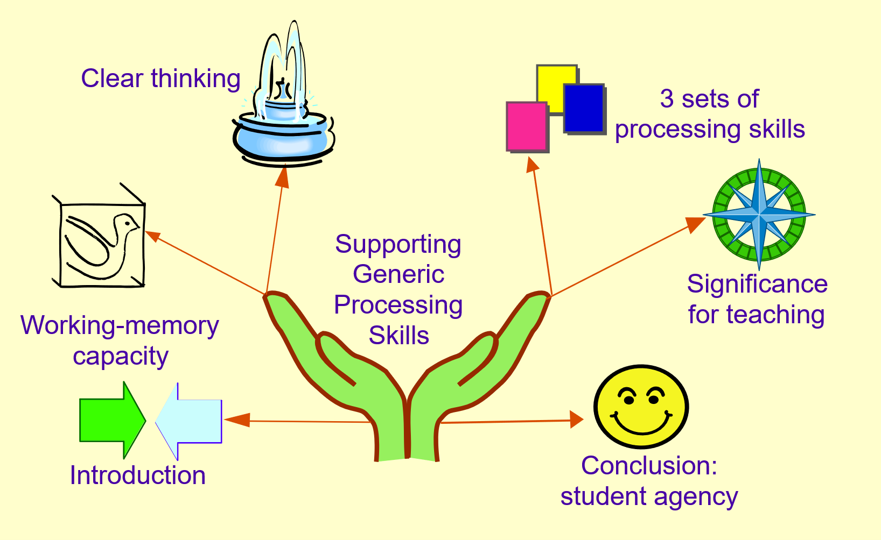
Plan
1) some details 2) a bit about me 3) a bit about you

Slide 5
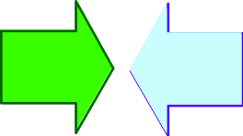
Some details
1 activity
slides not in handouts
if something is not clear, please ask; most questions and discussion, later
we will end on time – I have an alarm set for moving into the ending material

Slide 6
About me
I am dyslexic
Somervillian with 2 degrees in physics, but can’t do arithmetic
I set up the support system at Oxford Brookes from scratch for 13 years
I work by getting people to do activities

Slide 7
About you
education level
subject areas
primary school
secondary school
higher education
languages
maths
humanities
sciences
social sciences
arts

Slide 8
W-M capacity section
4 chunks
links
no links
no learning
chunking
making links

Slide 9
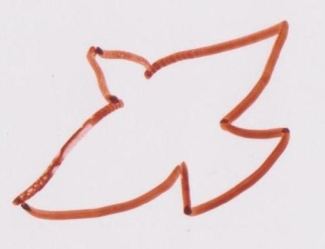
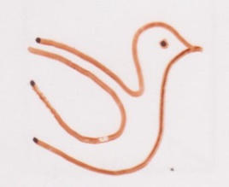
4 chunks: working-memory capacity
Baderley 1982, 2007
Notes:
ANIMATION:
fly in: 4 pigeons, singly
5th in and 1st out
Seems to be an extra click at the end

Slide 10
No learning – spelling
e
p
l
a
p
Notes:
ANIMATION:
fly in: 4 pigeons, singly
5th in and 1st out
Seems to be an extra click at the end

Slide 11
No learning – reading comprehension
working
is
limited
memory
to
capacity
Notes:
ANIMATION:
fly in: 4 pigeons, singly
5th in and 1st out
Seems to be an extra click at the end

Slide 12
No learning - processing skills
reading: e.g. scanning text
writing skills: e.g. planning
taking notes: e.g. key words
listening*: e.g. comprehension
speaking*: e.g. staying on topic
many more
*oracy skills

Slide 13
Processing skills to support
reading:
writing skills:
taking notes:
listening*:
speaking*:
the sub-skills need supporting
partial lists in handout
fuller lists in Gaining Knowledge and Skills with Dyslexia/ SpLDs
*oracy skills

Slide 14
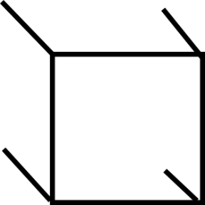
Chunking to increase working-memory capacity
creating links
between
different letters, words, ideas

Slide 15
Activity – making links
milk
tennis racket
paperclips
glue
hat

Slide 16
Skills for making links – thinking preferences
Key for capturing information
Additional for memorising, manipulating
verbal
visual
physical, kinaesthetic
framework, rationale
linear vs holistic
Myers-Briggs
Multiple Intelligences
sundry extra
other

Slide 17
Clear thinking section
calm pulse
erratic pulse
full brain
energy cut-off

Slide 18
Pulse and breathing rhythms
Watkins,2014

Slide 19
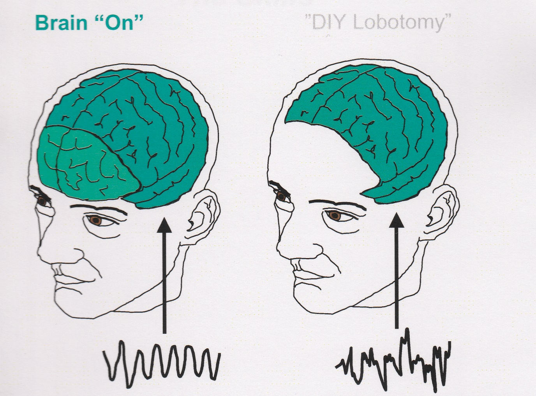
Full brain or partial
Brain “on”
“DIY Lobotomy”
Watkins,2014

Slide 20
Skills for clear thinking
deep breathing
physically relaxing
mindfulness
short physical movement – Brain Gym
music break
other systems

Slide 21
3 sets of skills section
processing skills
thinking preferences – linking
clear thinking

Slide 22
3 sets of skills to support processing skills
Prerequisites:
thinking preferences for making links
especially for capturing information
methods to maintain clear thinking
Supporting:
processing skills

Slide 23
Teaching section
presentation
principles
cautions

Slide 24
Presentation
verbal
visual
physical, kinaesthetic
framework, rationale
static material

Slide 25
Teaching the skills
deliberately
overtly
name
immediately relevant
regular practice
static material

Slide 26
Cautions
rote learning
subliminal learning
set in stone
out of sight, out of mind

Slide 27
Conclusion section
summary
agency
resources

Slide 28
Summary: skill sets
3 sets of skills to teach:
thinking preferences to increase links for working memory
clear thinking to maintain brain function
processing skills to promote student agency

Slide 29
Summary: teacher action
presentation elements:
visual
verbal
physical
rationale/ framework
handover to students: teach them the skills

Slide 30
Summary: Agency
Teachers shouldn’t do too much
Student agency brings confidence, which leads to potential being realised.

Slide 31
References
Baddeley, Alan, 1982, Your Memory: A User’s Guide, Penguin Books, London
Baddeley, Alan, 2007, Working Memory, Thought and Action, Oxford University Press (p145 4 chunks, pigeon holes, of memory)
Watkins, Alan, 2014, Coherence: the Secret Science of Brillian Leadership, Kogan Page, London

Slide 32
Resources In the handout
details for the 3 sets of skills with connections to books in series Living Confidently with Specific Learning Difficulties
useful links to www.dyslexia-strategies.com

Slide 33
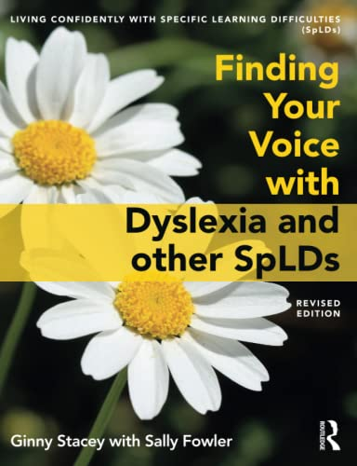
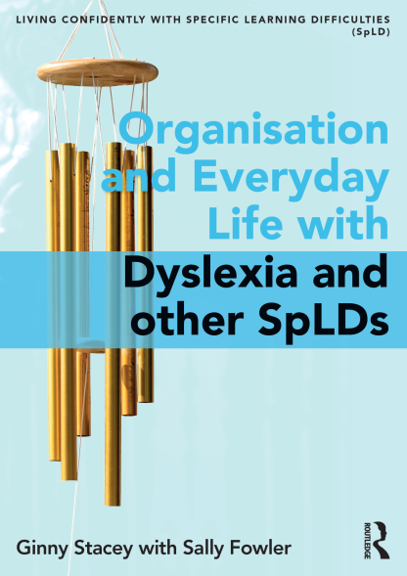
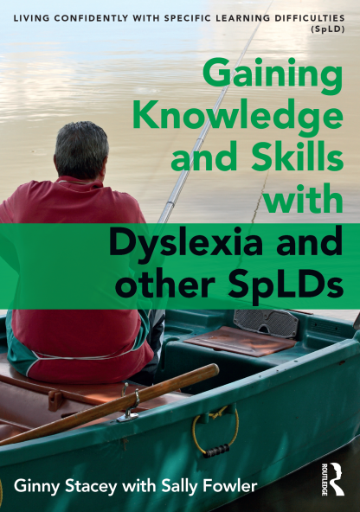
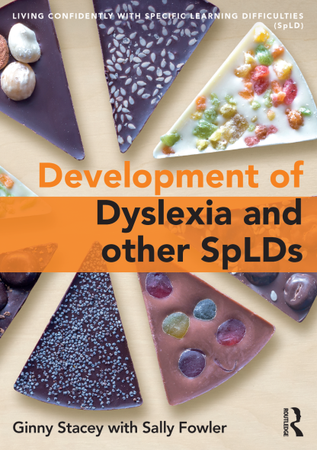
Living Confidently with Specific Learning Difficulties (SpLDs)
Book 1 Book 2 Book 3 Book 4
2019, 2020 2021 2020
2021
www.routledgetextbooks.com/textbooks/stacey

Slide 34
Living Confidently with Specific Learning Difficulties (SpLDs)
Book 1 covers working memory, thinking
preferences and clear thinking
Book 2 covers the wide-range of impacts
of dyslexia/ SpLDs
Book 3 covers imparting knowledge and skills, including the processing skills
Book 4 covers the experience of dyslexia/ SpLD and proposes a new paradigm
Notes:
Notes for future:
To produce out line in Word: MS office button > publish > create handouts in word > outline only
In Word> alter text font & size / put everything into bullets and out again to get rid of non standard line feed character.
Set paragraph margins etc to something reasonable.
Then edit as required.
Or notice the outline tab & copy & paste from there. Same amount of editing needed. A list of slides is very useful.

Slide 35
Living Confidently with Specific Learning Difficulties (SpLDs)
Stacey, Ginny, 2019, 2021, Finding Your Voice with Dyslexia and other SpLDs, Routledge, London
Stacey, Ginny, 2020a, Organisation and Everyday Life with Dyslexia and other SpLDs, Routledge, London
Stacey, Ginny, 2021, Gaining Knowledge and Skills with Dyslexia and other SpLDs, Routledge, London
Stacey, Ginny, 2020b, Development of Dyslexia and other SpLDs, Routledge, London

Slide 36
Thank you

