Slide 1
VISUAL IDENTITY PROJECT
Presentation to Governing Body
20.01.2021

Slide 2
Do we need a new visual identity?

Slide 3
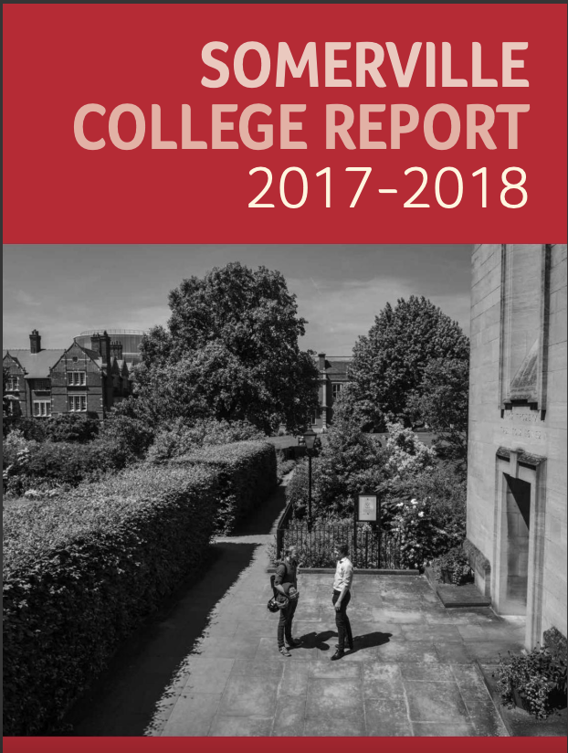
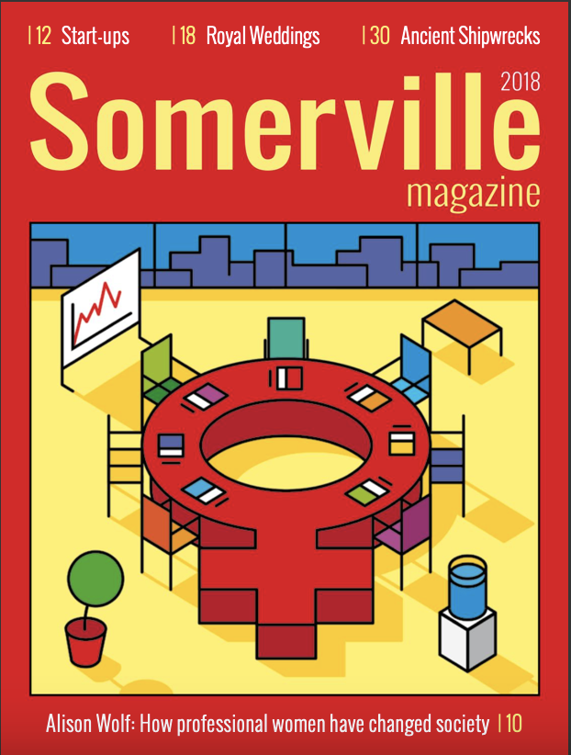
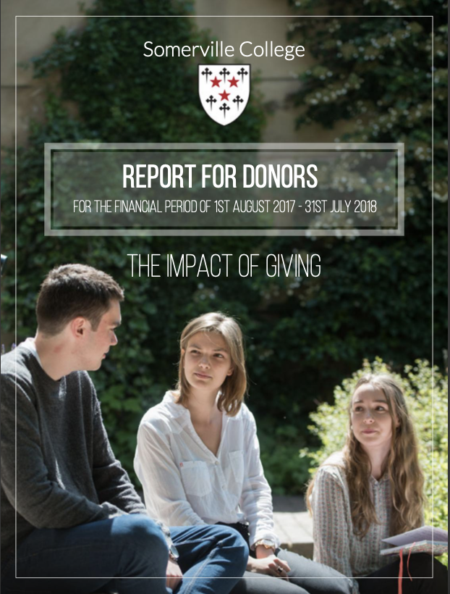

Slide 4
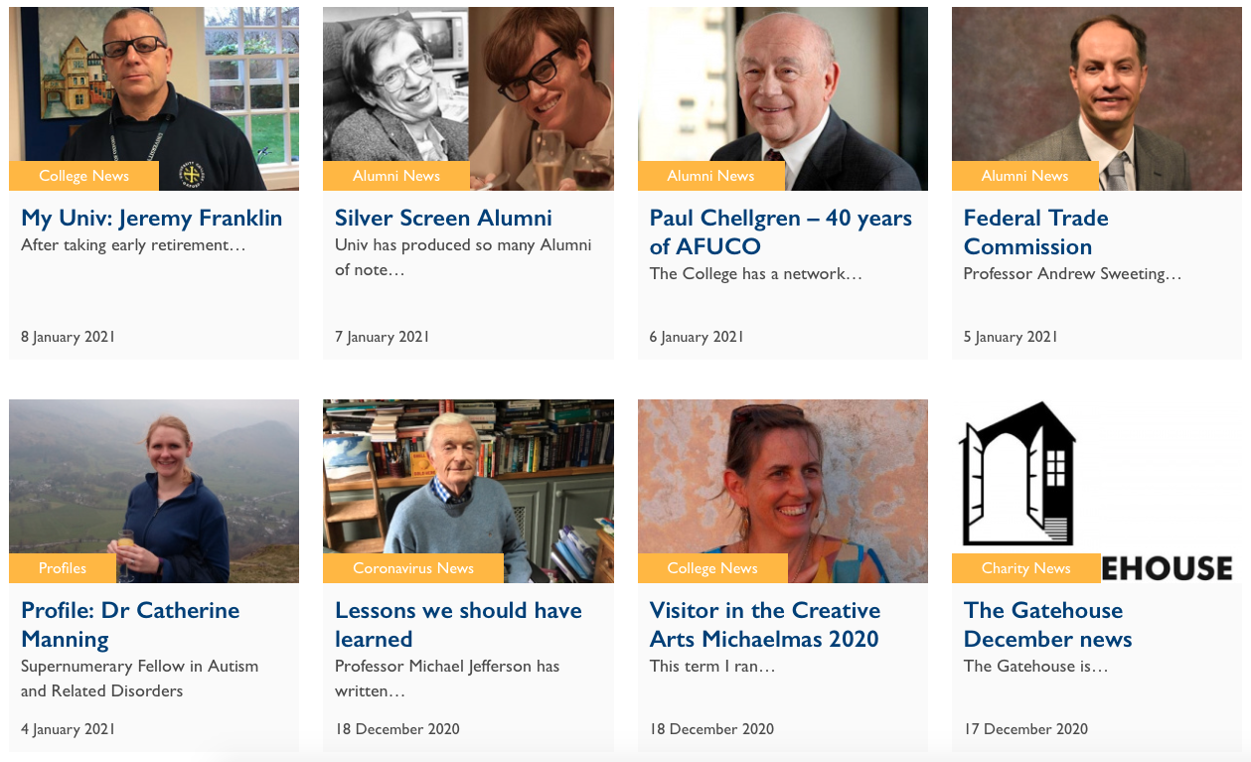

Slide 5
Do we need a new visual identity?
An organisation that looks and sounds like it knows itself and its purpose, which has the courage of its convictions…
- inspires trust
- develops sense of community
- sustains interest

Slide 6
The Brief
people really care, genuine warmth
bold / radical / life-affirming
the home of free thinking
…as different aesthetically as intellectually

Slide 7
A Note on Cost
Website development and RISE campaign coincided
Visual Philosophy already briefed for RISE campaign
Suggested opportunity to create a cohesive visual identity
and save money by combining the two briefs
Total bill: £9,950
RISE Campaign £5,800
Somerville visual refresh: £4,150

Slide 8
The Agency
retained Visual Philosophy, agency who did 140th and MTST work
briefed them with creating a suite of collateral for print, social, ambient
all supporting the Somerville ethos of bold, pioneering, warm, life-affirming

