Slide 1
It Doesn’t Take A Genius: the life and times of a mathematician
Dr. Eugenie Hunsicker
Loughborough University
LMS Women in Mathematics Committee Chair
Somerville Maths Reunion
24 June 2017

Slide 2
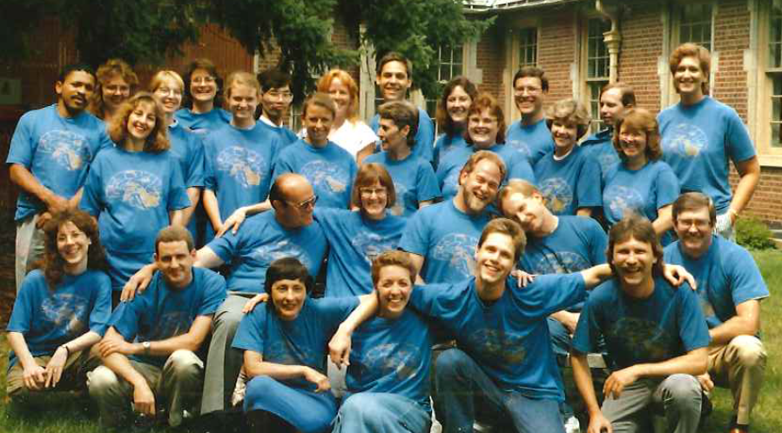
Starting University: Pre Med
Notes:
I didn’t think I could be a physicist, because I wasn’t a genius. But it never occurred to me that “mathematician” was a profession, so it didn’t occur to me I couldn’t do it. I took maths because I liked it.

Slide 3
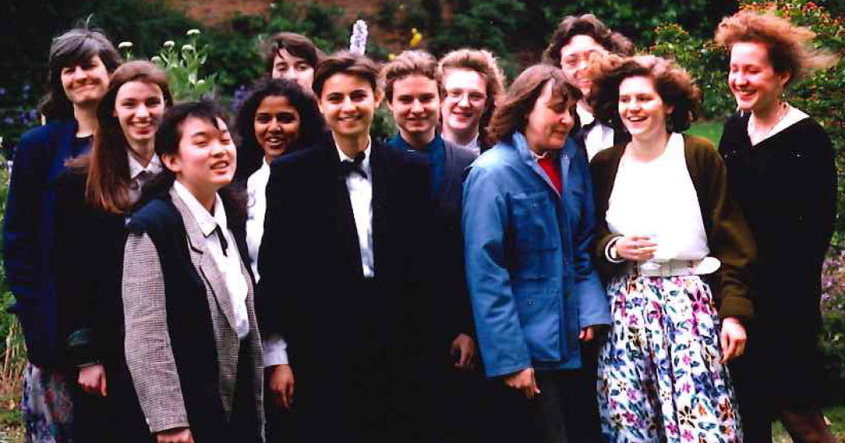
Junior Year Abroad: Oxford
Karin Erdmann, my first woman mathematics lecturer
Notes:
This year, I discovered I liked analysis.

Slide 4
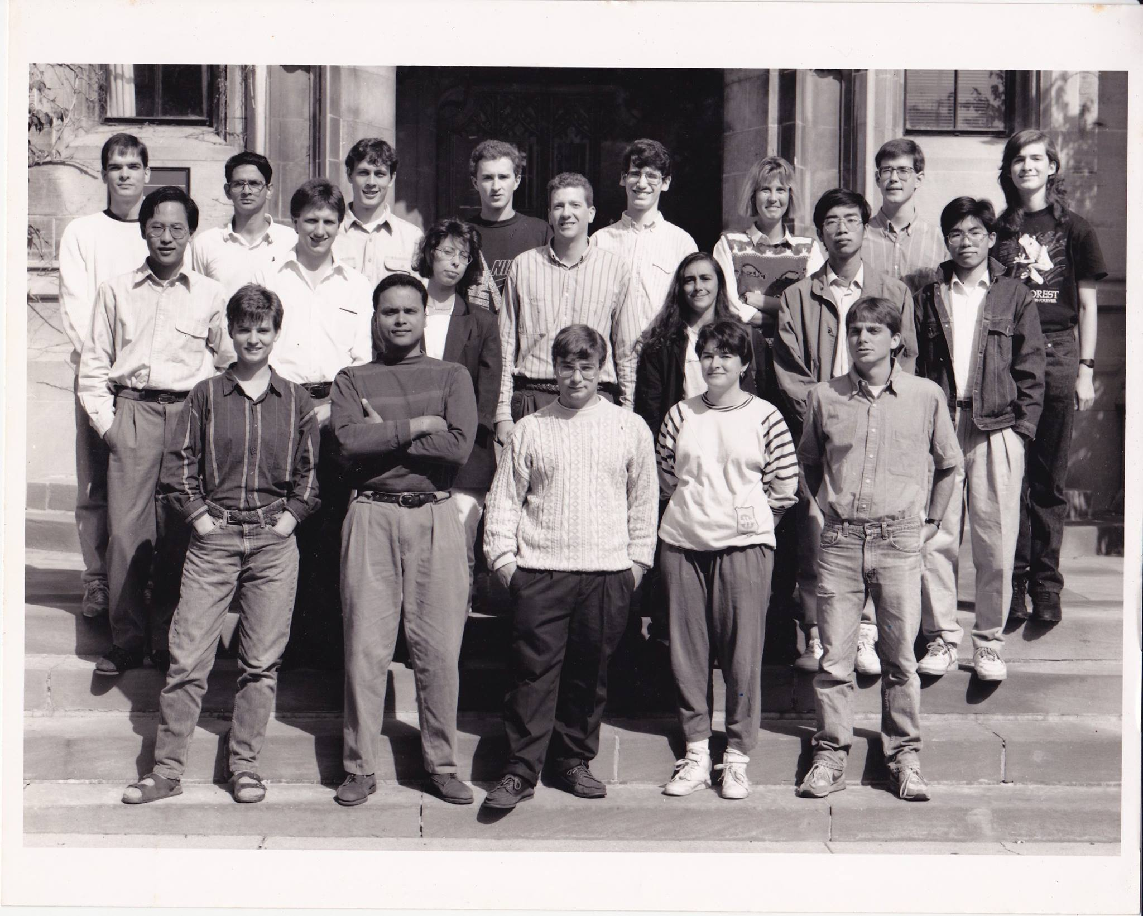
Graduate School: the Spartan approach to grad students
Notes:
When I got there, I felt really outclassed. I thought everyone was better than me.
19 in entering class. 11 completed PhD. 8 now in academic careers.

Slide 5
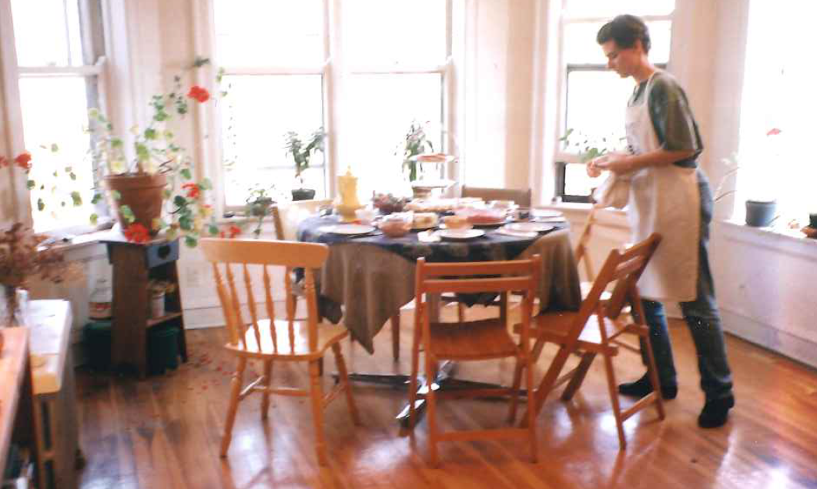
First Women in Maths Activities

Slide 6
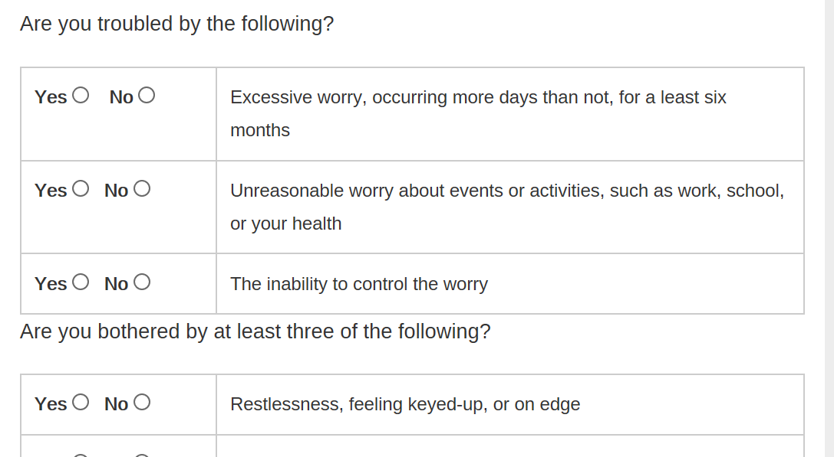
Mental Health:
Generalized Anxiety Disorder

Slide 7
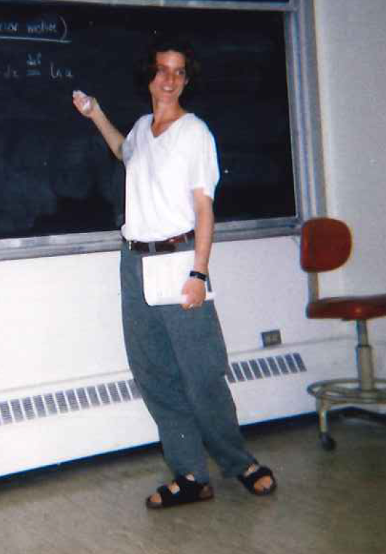
A Career in Teaching?

Slide 8
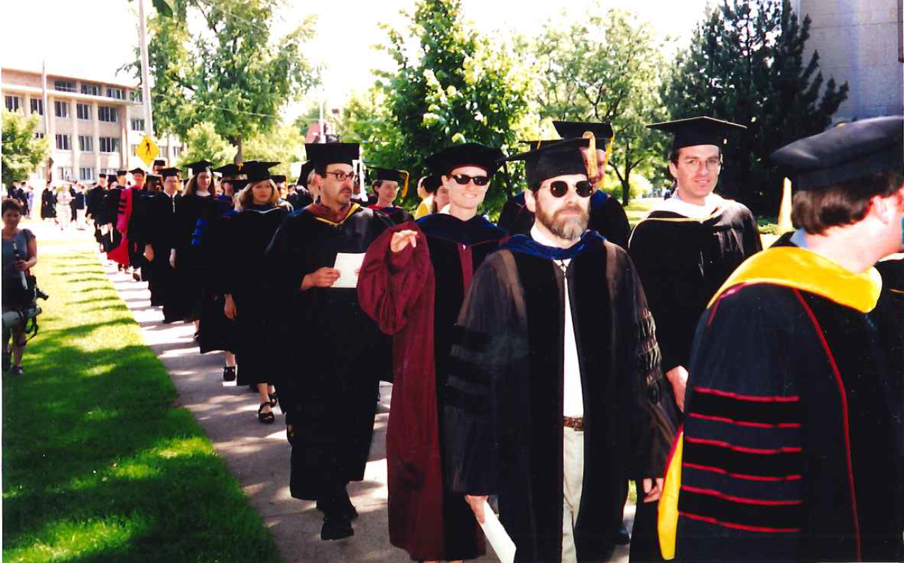
Working at a Liberal Arts College

Slide 9
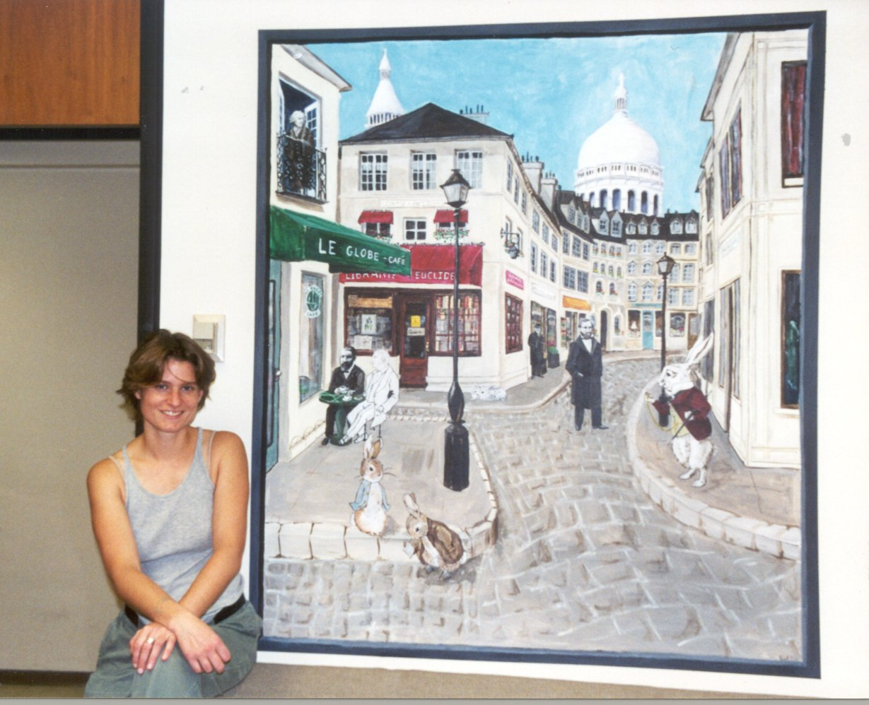
New Collaborations: Stanford

Slide 10
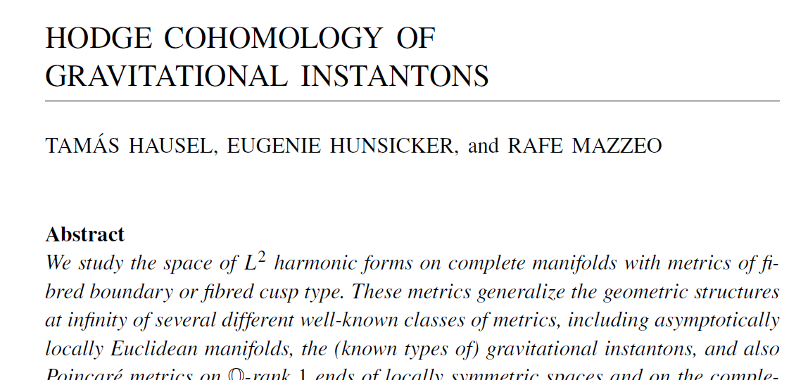
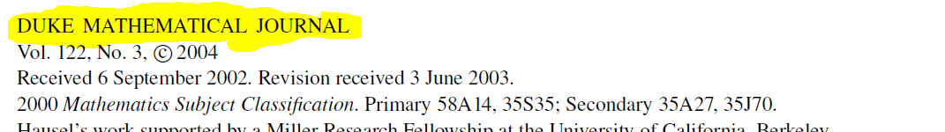
THE paper
(that got me a research job at Loughborough)

Slide 11
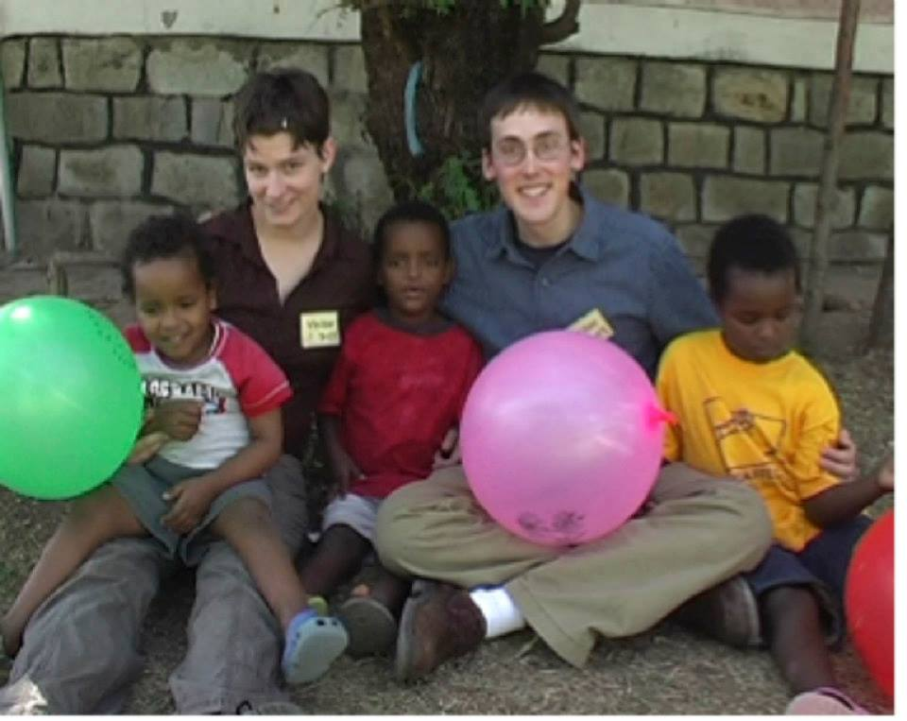
Adoption: the bureaucratic nightmare 2008-2010

Slide 12
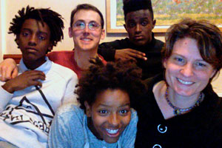
…and more recently

Slide 13
Starting a New Direction:
Statistics
2011: Start teaching (and learning!) undergraduate applied statistics, become programme director for new Mathematics with Statistics programme
Summer 2012: HEA Teaching Development Grant: Undergraduate summer research project to develop online resources and teaching materials
2012-13: Five final year undergraduate projects in different statistics topics
Summer 2013: Another undergraduate research project to develop online statistics resources, funded by Loughborough Teaching Innovation Award
2015: Midlife crisis—decision to change research
2015-16: Developing collaborations
2016: First PhD students in statistics
2017: First publications

Slide 14
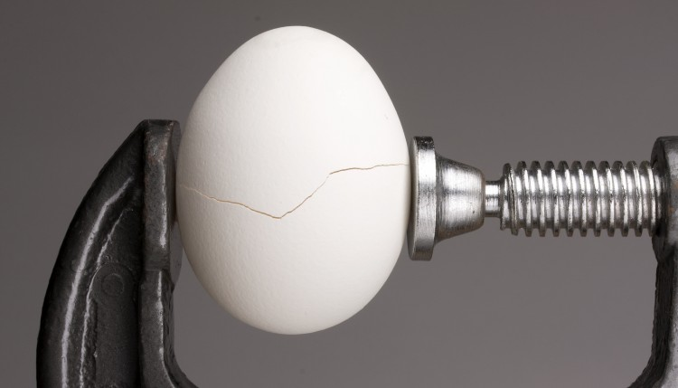
Characterising Materials:
Q: How do composition and structure influence materials properties?
Composition
Structure
Materials Properties
?
?
Rigaku.com: spectrograph of eggshell
The Stoddard Lab‪‬ www.marycstoddard.com : ‪An SEM image of an eggshell surface. © M. C. Stoddard.‬
www.monday-8am.com: eggshell in a vice

Slide 15
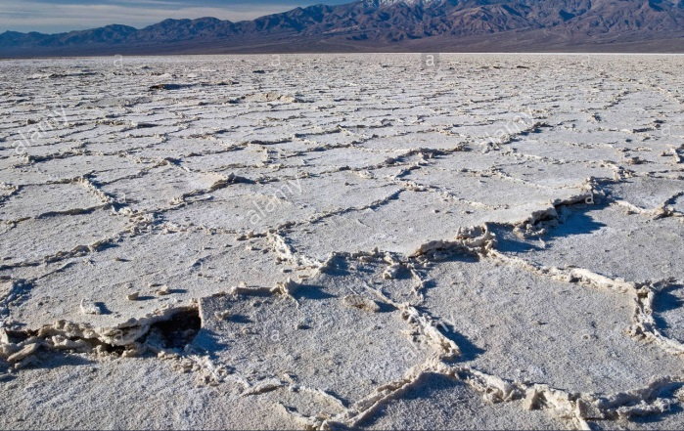
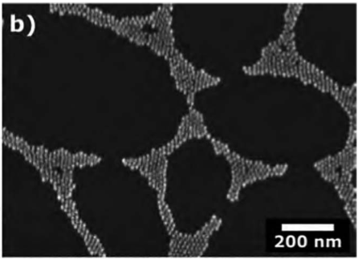
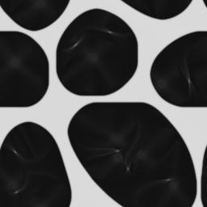
Creating materials:
How can we compare materials created in different ways?
Naturally occurring
Laboratory fabrication
?
Numerical Model
?
?
Salt Pans, evaporative deposition, Alamy stock photo
Gold Nanoparticle deposition: Kunstmann-Olsen et al, 2015
DDFT model

Slide 16

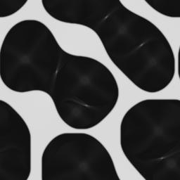
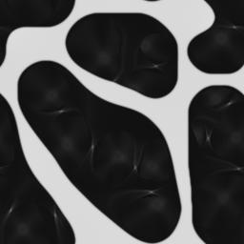

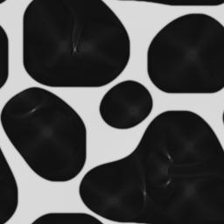
Materials Image data: Challenges
Random Variation
Cost of data
To overcome these, we need robust and efficient statistical methods for comparing image data.
http://www.microelectronics.scu.edu/REVISE/equipment.htm

Slide 17
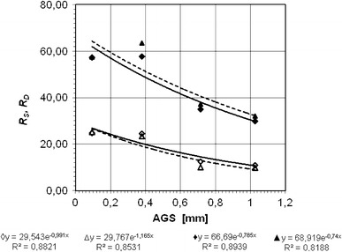
How do we do statistics on images?
Typical engineer approach: Calculate a few numbers from each of eight images and put in error bars ☺
Better approaches:
Machine learning/ bootstrapping and nonparametric statistics: excellent results when there is a vast amount of data. (e.g. Facebook profile photos)
Parametric statistics: use models to improve inferential ability with smaller amounts of data (small prototype batch of new material).
For the second approach, we need to be able to say how far apart two images are in some appropriate sense.

Slide 18
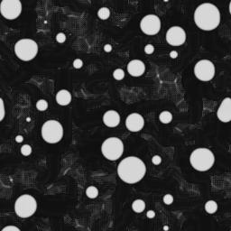
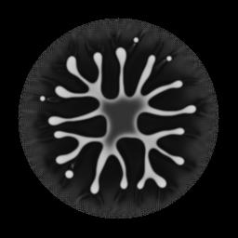
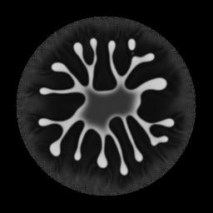

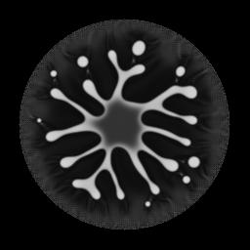
Challenges in parametric statistics of materials images
Describe good geometric models for material structures
Define and study distances between pairs of images
Grains or particles
Branches or capillaries
Pores or cells
Periodic structures,
Multiscale structures
Which two images are the closest?

Slide 19
The third (and often largest!) part of the job: Admin and Service
2013: Member of London Mathematical Society Women in Maths committee
2015: Chair LMS women in maths committee
  Athena Forum member
  Service Teaching Coordinator
2016: sigma steering group member
2017: Interim director, Centre for Imaging Science

Slide 20
Sometimes I ask myself…
Have I had a successful mathematics career?

Slide 21
Why is everyone so worried about women in mathematics?
The UK has a desperate need for highly numerate employees. We can’t afford to discourage half the population from such careers.
Mathematics and industry both benefit from a diverse set of viewpoints and experiences.
The UK has lower participation rates by women in maths than other EU countries.
Despite the years since open discrimination was banned, women are still only 7.4% of mathematics professors are women—the numbers at highest levels in industry are not much different.

Slide 22
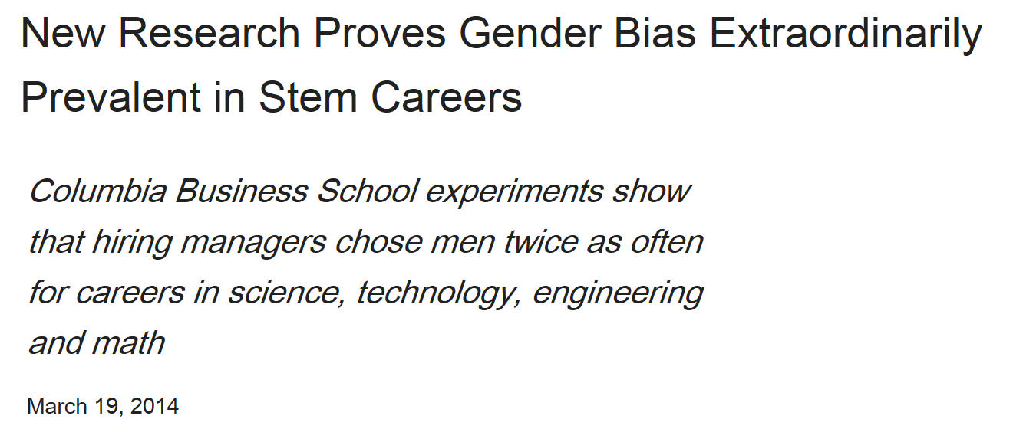
Some Research:
The Impact of Implicit Bias

Slide 23
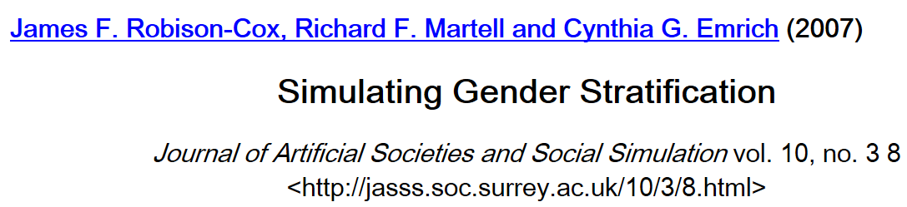
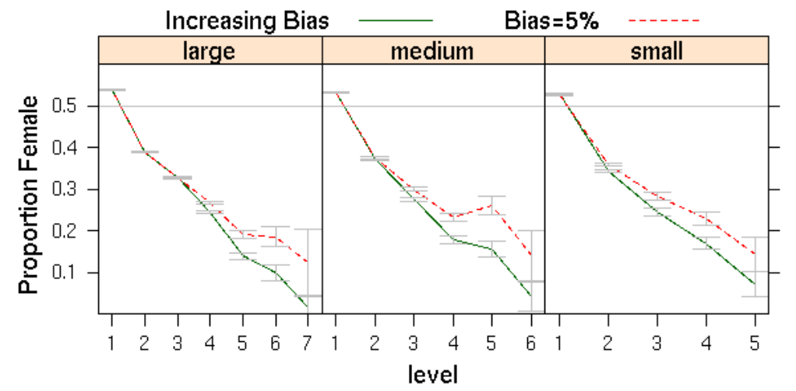
Some Research:
The Impact of Implicit Bias

Slide 24
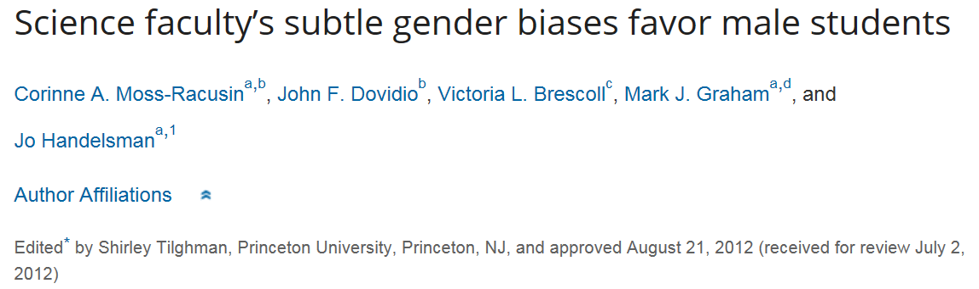
Some Research:
The Impact of Implicit Bias

Slide 25
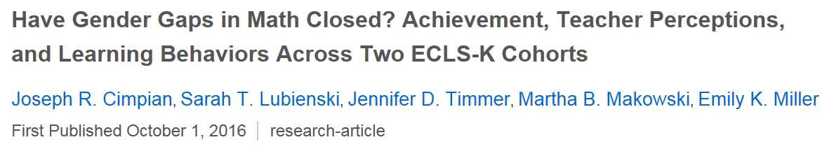
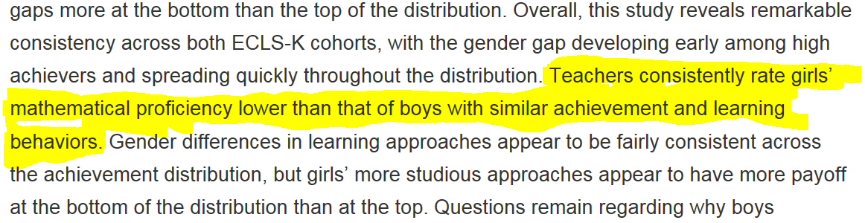
Some Research:
The Impact of Implicit Bias
Already when students are 5 years old!

Slide 26
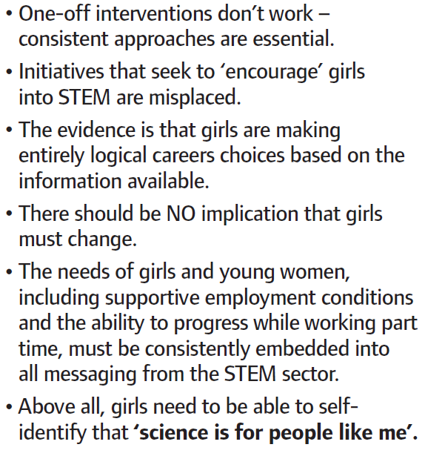
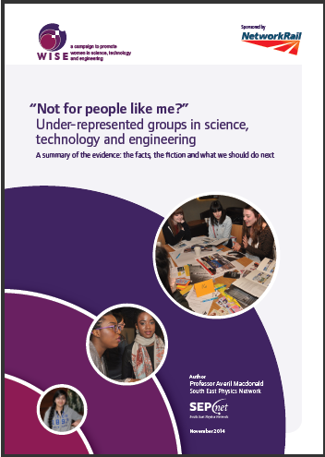
Some WISE conclusions

Slide 27
We need to change POLICIES.
We need to change CULTURE.
This is EVERYONE’S problem.

Slide 28
LMS women in maths activities
Policy:
Good Practice Scheme
Policies within LMS
Carer grants, Grace Chisholm Young fellowships
Culture:
Women and Girls in Maths events
Mary Cartwright Lecture
Anne Bennet Prizes
Success Stories project

Slide 29
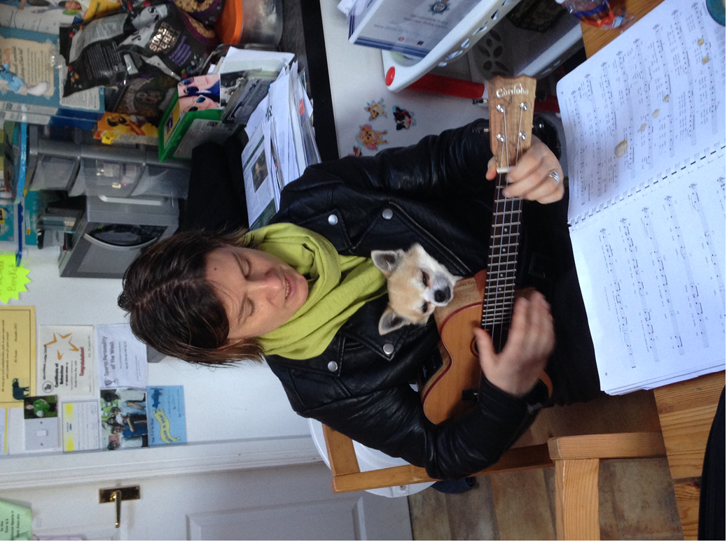
Thanks for
listening!

